Slide 1

Microsoft Azure Well-Architected Build and manage high-performing workloads

Slide 2

Why is being well-architected important?

Slide 3

Well-architect and optimize workloads for success
Build workloads with confidence using proven best practices
Actionable and simple to use deep technical resources to design workloads that show results
Know where to focus to optimize workloads

Slide 4


What is the Well-Architected Framework?

Slide 5
Microsoft Azure Well-Architected Framework
Architecture guidance and best practices, created for architects, developers and solution owners, to improve the quality of their workloads, based on 5 aligned and connected pillars
Cost Optimization | Operational Excellence | Performance Efficiency | Reliability | Security

Slide 6


Proven guidance to support the cloud journey
Meeting different persona needs at different altitudes
Central IT
Workload Owners
Portfolio
Landing zones
Cloud Platforms
Workloads
Assets
Define strategy
Define business justification and expected outcomes
Plan
Align actionable cloud adoption plan to business outcomes
Ready
Prepare process and environment for deployment
Adopt
Migrate or Innovate
Implement desired changes and deploy workloads
Govern
Comply, control and secure
Manage
Operate and optimize
Microsoft Cloud Adoption Framework for Azure
Azure Well-Architected Framework
Notes:
We currently have the cloud adoption framework which we have been leveraging to engage the Central IT teams,TDMs,BDMs and driving conversations that typically start at the portfolio and platform level and cover the different stages of the customer cloud journey.
We now have the Well Architected framework that addresses the need of the workload owners by providing technical guidance to help design, deploy and manage workloads in Azure.
With Cloud adoption framework and Well Architected framework, we are able to have inclusive customer conversations and we are able to address the needs of different personas.

Slide 7
What is a Workload?
A "workload" or "application" is a resource or collection of resources that provide end-to-end functionality to one or multiple clients (humans or systems).
Another way to think of it; a workload is an end-to-end scenario (a process, a journey, a business operation) and the IT infrastructure supporting it.
It can be one or multiple applications, APIs and databases working together to deliver a specific functionality.

Slide 8




Azure Well-Architected Build and manage high-performing workloads
Build workloads with confidence with proven best practices
Design high-performing workloads using deep technical guidance
Optimize workloads with actionable focus areas
Azure
Well-Architected
Review
Reliability
Design
Principles
Azure
Advisor
Cost Optimization
Azure
Well-Architected
Framework
Operational Excellence
Performance Efficiency
Reference
Architectures
Documentation
Security
Partners, Support &
Services Offers
Notes:
With the Microsoft Azure Well-Architected Framework you can BUILD workloads with confidence based on proven deep technical guidance, that is actionable and simple-to-use, and helps you identify areas of improvement, and where to focus your workloads optimization efforts.​
​
Well-Architected enables you to achieve three things…..
BUILD with confidence across all workload deployments and operations against.
DESIGN workloads using actionable and simple-to-use deep technical guidance.
PERFORM gap analysis to identify areas of improvement, and where to focus optimization efforts.
The framework is at the center of an ecosystem of best practices, documentation, assessments, reference architecture, and design principles. All this supported and amplified by Partners and Services offers to guide and assist you in improving your workloads’ quality.​
​
Azure Well-Architected Framework enables you to achieving your business objectives, operationalizing how to design, build, and optimize cloud solutions.​
Microsoft Azure Well-Architected Review provides evaluates workloads with gap analysis and identifies areas of where to focus your optimization efforts.​
Reference Architectures help you to build and deploy any workload to scale and meet your business needs.​
Design principles based on proven practices and design patterns from successful customer and partner deployments.​
Microsoft Partner & Service Offers support you—and help you build effective cloud solutions.​
But, building optimized workloads is a shared responsibility.

Slide 9
Best practices to drive workload quality
Cost Optimization | Operational Excellence | Performance Efficiency | Reliability | Security
Monitor and forecast Cost controls Azure Hybrid Benefit Reserve Instances Shutdown Resize Move to PAAS | DevOps Deployment Monitor Processes and cadence | Design for scaling Monitor performance | Define requirements Test with simulations and forced failovers Deploy consistently Monitor health Respond to failure and disaster | Identity and access management Infra protection App security Data encryption and sovereignty Security operations

Slide 10

Overcoming workload quality inhibitors
Cost Optimization
Operational Excellence
Performance Efficiency
Reliability
Security
No cost and usage monitoring
Unclear on underused or orphaned resources
Lack of structure billing management
Budget reductions due to lack of support for cloud adoption by LT/board
Lack of rapid issue identification
No deployment automation
Absence of communication mechanisms and dashboards
Unclear expectations and business outcomes
No visibility on root cause for events
No monitoring new services
No monitoring current workloads health
No design for scaling
Lack of rigor and guidance for technology and architecture selection
Unclear on resiliency features/capabilities for better architecture design
Lack of data back up practices
No monitoring current workloads health
No resiliency testing
No support for disaster recovery
No access control mechanism (authentication)
No security threat detection mechanism
Lack of security threat response plan
No encryption process
https://aka.ms/wellarchitected/framework
Notes:
These are a sample of the quality inhibitors to look out and that could be addressed by the guidance included in Microsoft WAF, representing both the breadth and depth of guidance provided by Microsoft.

Slide 11
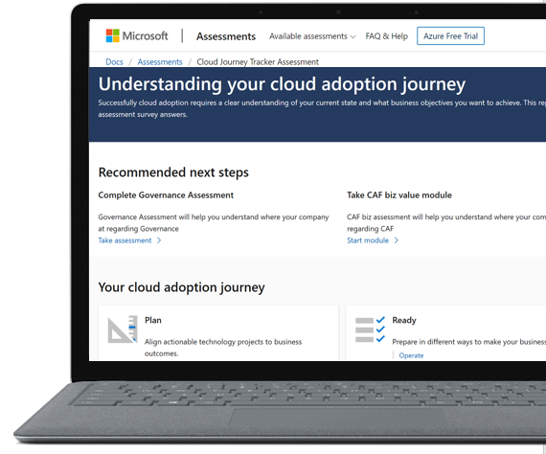
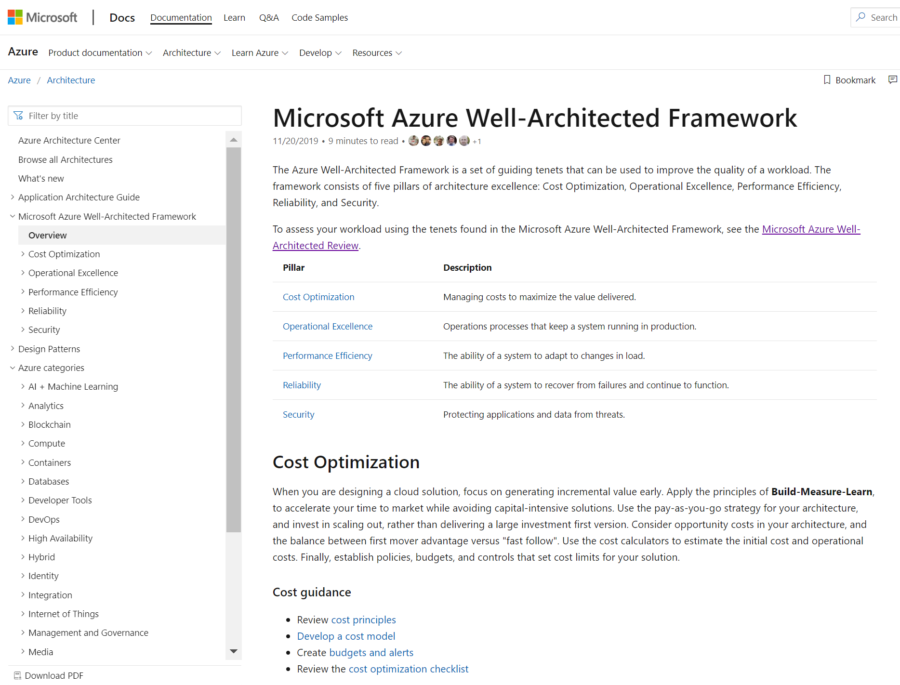
Microsoft Azure Well-Architected Framework
Documentation
https://aka.ms/wellarchitected/framework
Notes:
Microsoft Azure Well-Architected Framework
The Microsoft Azure Well-Architected Framework is a set of guiding tenets that can be used to improve the quality of a workload.
The framework consists of five pillars of architecture excellence: Cost Optimization, Operational Excellence, Performance Efficiency, Reliability, and Security

Slide 12
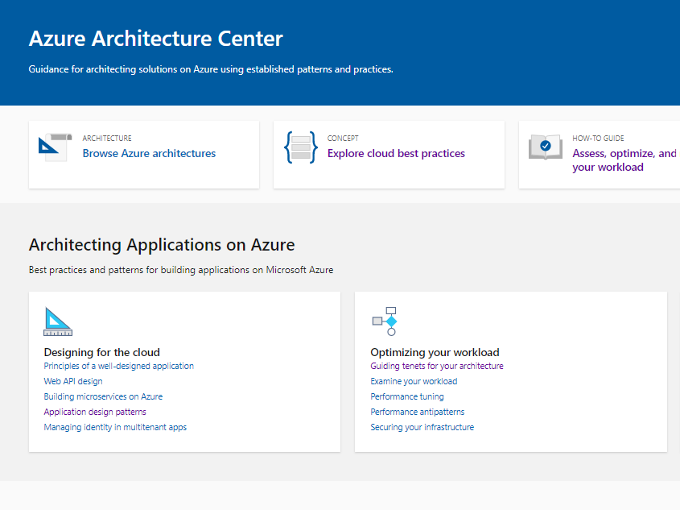
Microsoft Azure Architecture Center
Documentation
https://aka.ms/architecture
Notes:
Azure Architecture Center
Guidance for architecting solutions on Azure using established patterns and best practices to design and build more scalable, resilient, and manageable applications on Azure.

Slide 13
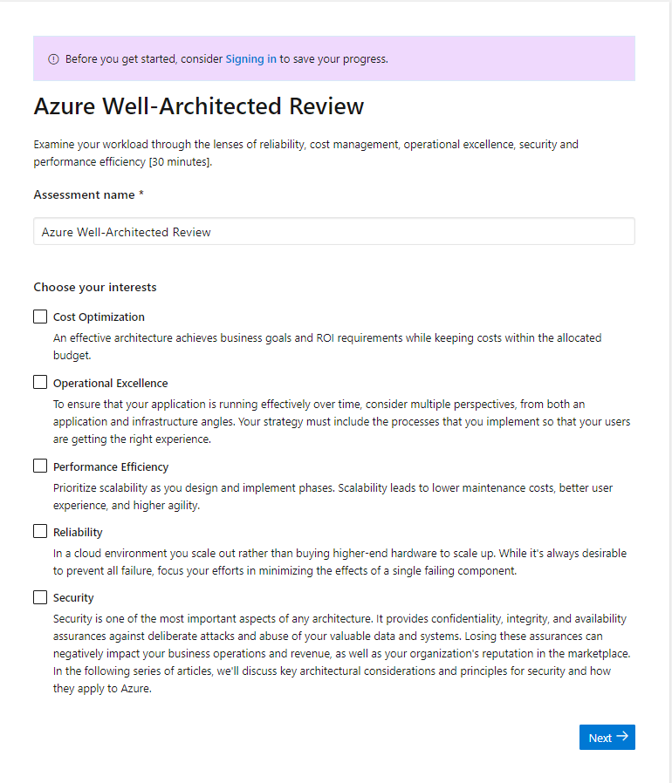
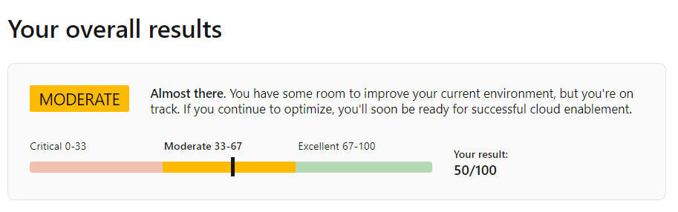
Well-Architected Review Online Tool
Assess your workloads using the tenets found in the Microsoft Azure Well-Architected Framework:
Understand the Well-Architected level of your workload environment.
Access guidance for next steps of your workload improvement process.
aka.ms/wellarchitected/review
Notes:
Then, the Well-Architected Review will help you, with a set of simple guided questions, to assess your workloads operational capabilities and give you guidance for the next steps of your workload improvement process.

Slide 14
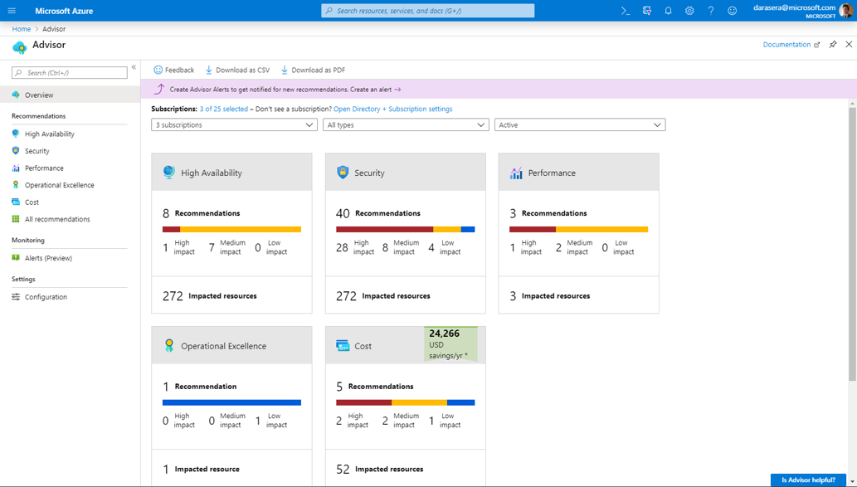
Azure Advisor
Practical recommendations based on your usage and configurations, such as:
Create Azure Service Health alerts.
Delete and re-create your pool to remove a deprecated internal component.
Repair invalid log alert rules.
Design your storage accounts to prevent reaching the maximum subscription limit.
Azure.com: aka.ms/advisor Tool: aka.ms/azureadvisor Documentation: aka.ms/docs/advisor
Notes:
Let’s start with Azure Advisor. This tool analyzes your configurations and usage telemetry and offers personalized, actionable recommendations to help you optimize your Azure resources.

Slide 15
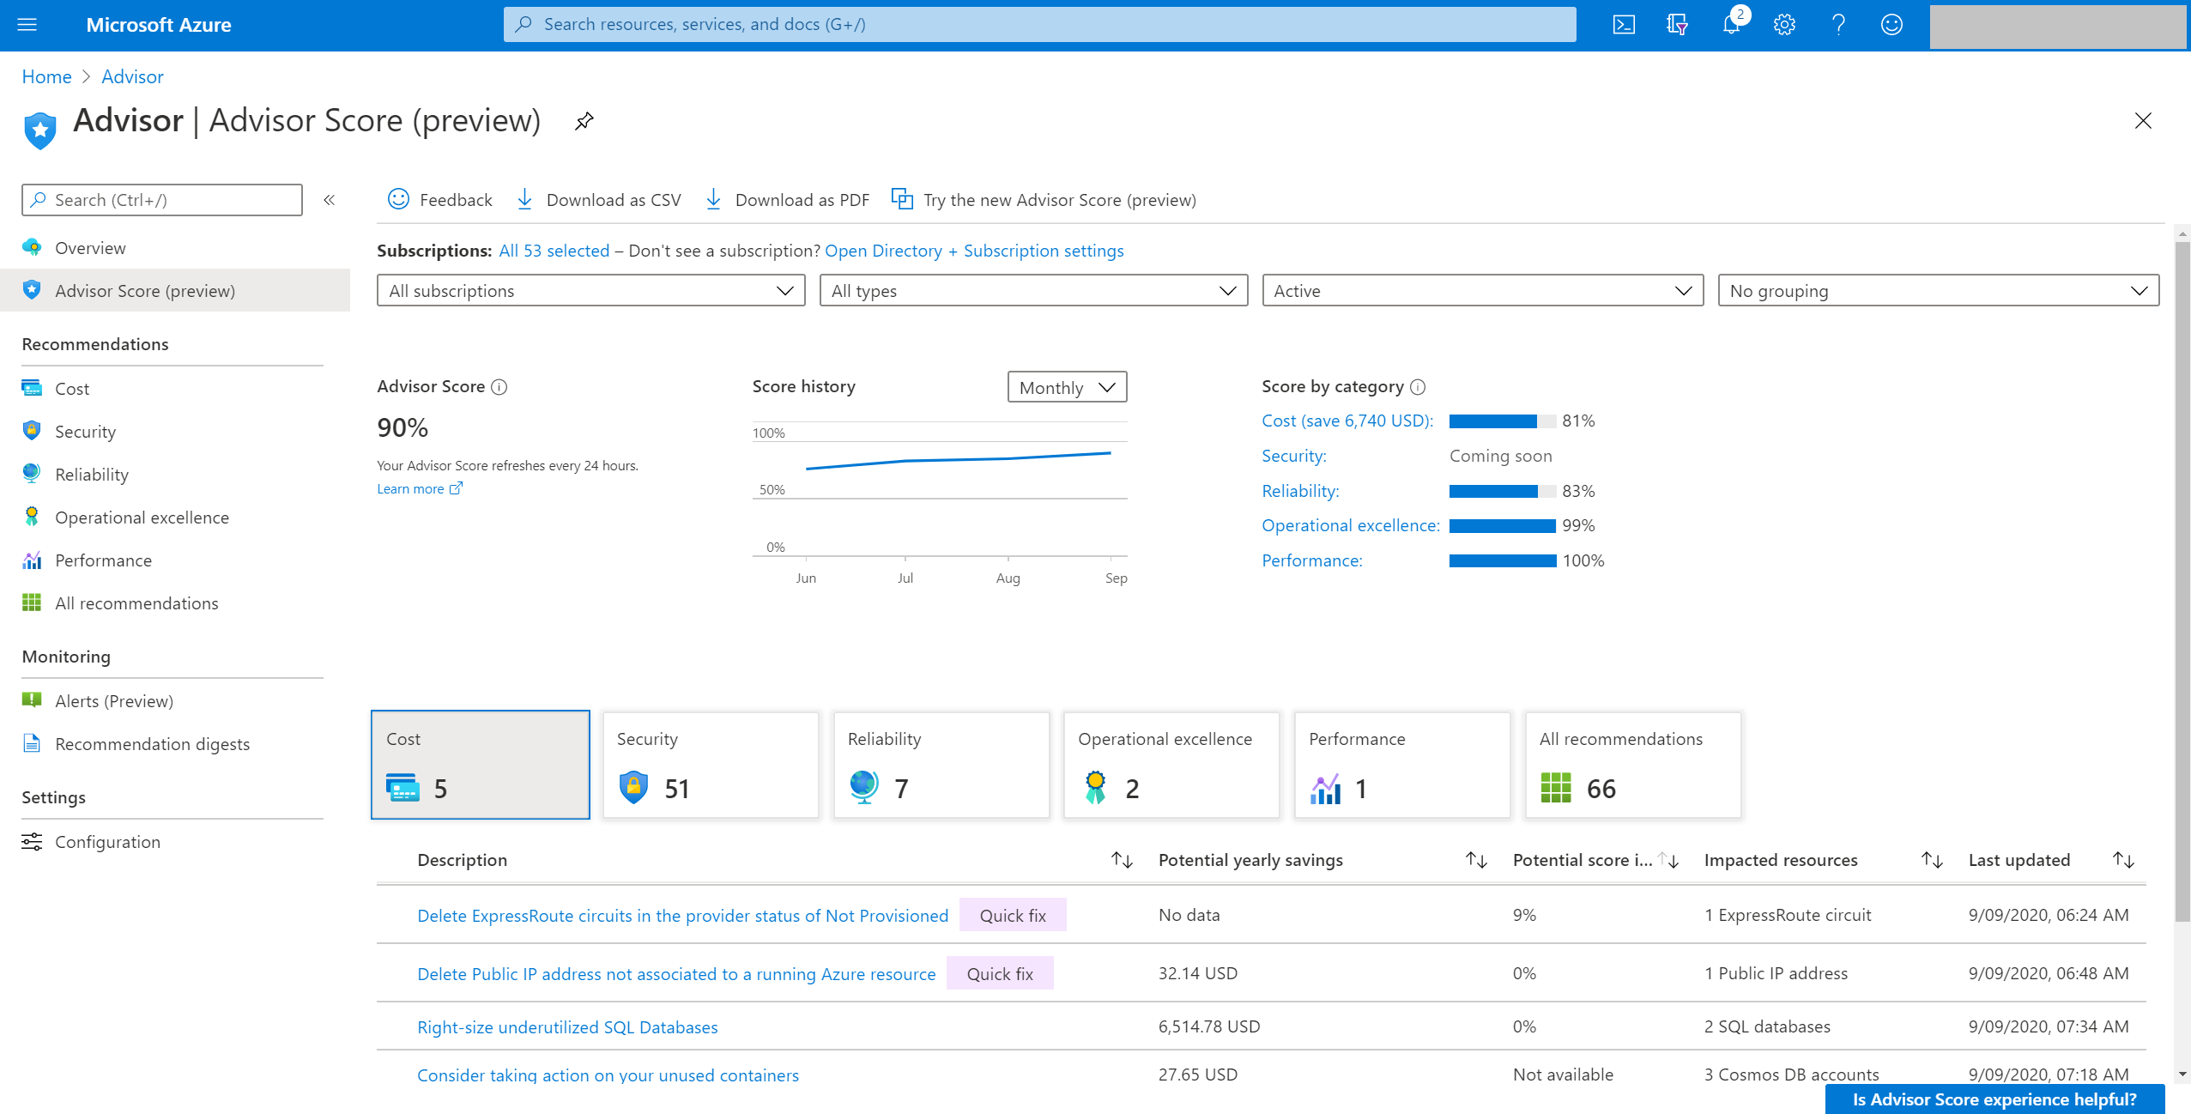
Advisor Score A core feature of Azure Advisor that aggregates recommendations into a simple, actionable score.
Personalized and actionable best practice recommendations, including how to:
Improve the posture of your workloads and optimize your Azure deployments.
Proactively prevent top issues by following best practices.
Assess your Azure workloads against the five pillars of the Microsoft Azure Well-Architected Framework.
Azure.com: aka.ms/advisor
Tool: aka.ms/azureadvisor
Documentation: aka.ms/docs/advisor
Notes:
Advisor displays your overall Advisor score and a breakdown for Advisor categories, in percentages. A score of 100% in any category means all your resources assessed by Advisor follow the best practices that Advisor recommends. On the other end of the spectrum, a score of 0% means that none of your resources assessed by Advisor follow Advisor's recommendations
Using these score grains, you can easily achieve the following flow:
Advisor Score helps you baseline how your workload or subscriptions are doing based on an Advisor score. You can also see the historical trends to understand what your trend is.
Score by category for each recommendation tells you which outstanding recommendations will improve your score the most. These values reflect both the weight of the recommendation and the predicted ease of implementation. These factors help to make sure you can get the most value with your time. They also help you with prioritization.
Category score impact for each recommendation helps you prioritize your remediation actions for each category.

Slide 16

Building Well-Architected workloads— is a shared responsibility
Customer application
Customer app or workload, built on the Azure platform
Scope of Well-Architected
Assessments
Platform features
Optional Azure capabilities a customer enables – to ensure security, reliability, operability, performance
Platform foundation
Core capabilities built into the Azure platform – how the foundation is designed, operated, and monitored
Notes:
Building well-architected workloads is a shared responsibility.
Azure enables platform capabilities and features, but the customer must build well-architected workloads, with knowledge of their own architecture requirements.
Observe graphic on slide, and explain these points, from the bottom up:
Azure's hybrid model—with unified operational management control processes and governance management—offers multiple solutions, enabling customers to confidently deliver hybrid workloads.
Azure provides customers with the controls, methods, tools, and support
The customer brings a deep understanding of their goals, constraints, and requirements, along with knowledge specific to their industry.
Let's look at what it looks like to make tradeoffs in a business context.

Slide 17
Microsoft Azure Well-Architected
Partner &
Service Offers
Documentation
Azure Well-Architected Review
Cost Optimization
Security
Operational
Excellence
Reliability
Performance Efficiency
Reference
Architectures
Design Principles
Azure Advisor

Slide 18
Thank you!

